Slide 1


<Name>
<Date>

Slide 2

Outline
Executive Summary
Introduction
Methodology
Results
Conclusion
Appendix

Slide 3
Executive Summary
Collected the data related to SpaceX rocket launch from SpaceX website and Wikipedia Page. Performed Exploratory data analysis on the dataset to see how the columns are correlated and to find the best labels to perform the data analysis. Then created a map using Folium to see which rocket launch sites has most successful rate and at last utilized the machine learning algorithms Such as GridSearch to find the accuracy.
The used machine learning models are: GridSearch, Decision Tree, Support Vector Machine, K-Nearest Neighbor. The predicted accuracy of most of models was around 83.33%.

Slide 4
Introduction
Background
Commercial Space Age is Here
Space X has best pricing ($62 million vs. $165 million USD)
Largely due to ability to recover part of rocket (Stage 1)
Space Y wants to compete with Space X
Task
To train a machine learning model and use public information to predict if SpaceX will reuse the first stage

Slide 5

Section 1

Slide 6
Methodology
Executive Summary
Data collection methodology:
Data was collected from SpaceX Public API and Wikipedia Page
Perform data wrangling
Calculated the number of launch on each site
Calculated the number and occurrence of each orbit
Calculated the number and occurrence of mission outcome per orbit
Created a landing outcome from outcome column
Perform exploratory data analysis (EDA) using visualization and SQL
Perform interactive visual analytics using Folium and Plotly Dash
Perform predictive analysis using classification models
Utilized GridSearch

Slide 7
Data Collection
Data collection process involved a combination of API requests from Space X public API and web scraping data from a table in Space X’s Wikipedia.
Space X API Data Columns:
FlightNumber, Date, BoosterVersion, PayloadMass, Orbit, LaunchSite, Outcome, Flights, GridFins,
Reused, Legs, LandingPad, Block, ReusedCount, Serial, Longitude, Latitude
Wikipedia Webscrape Data Columns:
Flight No., Launch site, Payload,

Slide 8
Data Collection – SpaceX API
Present your data collection with SpaceX REST calls using key phrases and flowcharts
https://github.com/SauravDeb-98/IBM-Capstone-Project/blob/main/jupyter-labs-spacex-data-collection-api.ipynb
Requesting rocket launch data
Using json_normalize meethod to convert the json result into a dataframe
Use API again to get information about the launches using the IDs given for each launch. Specifically we will be using columns rocket, payloads, launchpad, and cores
Remove the missing values with mean and export into dataset_part_1.csv
Filter the dataframe to only include Falcon 9 launches

Slide 9
Data Collection - Scraping
https://github.com/SauravDeb-98/IBM-Capstone-Project/blob/main/jupyter-labs-webscraping.ipynb
Requesting the data of Falcon 9 from Wikipedia URL
Extracting the column names from HTML header using BeautifulSoup
Creating a dataframe and exported to spacex_web_scraped.csv

Slide 10
Data Wrangling
After extracting the data from the dataset, the total percentage of missing values are counted. Then the total number of launches on each site is calculated using value_counts(), then occurenece of each orbit is calculated and then using the method .value_counts() on the column Outcome to determine the number of landing_outcomes.Then assign it to a variable landing_outcomes. The another column is created where 0 means bad outcome and 1 means landed successfully
https://github.com/SauravDeb-98/IBM-Capstone-Project/blob/main/IBM-DS0321EN-SkillsNetwork_labs_module_1_L3_labs-jupyter-spacex-data_wrangling_jupyterlite.jupyterlite.ipynb
Calculate the number of launches on each site
Calculate the number and occurrence of each orbit
Calculate the number and occurence of mission outcome per orbit type
Create a landing outcome label from Outcome column

Slide 11
EDA with Data Visualization
Visualize the relationship between Flight Number and Launch Site.
Visualize the relationship between Payload and Launch Site
VAFB-SLC launchsite there are no rockets launched for heavypayload mass(greater than 10000).
Visualize the relationship between FlightNumber and Orbit type
Visualize the relationship between Payload and Orbit type
The sucess rate since 2013 kept increasing till 2020
https://github.com/SauravDeb-98/IBM-Capstone-Project/blob/main/IBM-DS0321EN-SkillsNetwork_labs_module_2_jupyter-labs-eda-dataviz.ipynb.jupyterlite.ipynb

Slide 12
EDA with SQL
SQL Queries performed are:
Displaying the names of the unique launch sites in the space mission
Displaying 5 records where launch sites begin with the string ‘CCA'
Displaying the total payload mass carried by boosters launched by NASA (CRS)
Displaying average payload mass carried by booster version F9 v1.1
Listing the date when the first successful landing outcome in ground pad was achieved
Listing the names of the boosters which have success in drone ship and have payload mass greater than 4000 but less than 6000
Listing the total number of successful and failure mission outcomes
Listing the names of the booster versions which have carried the maximum payload mass
Listing the failed landing outcomes in drone ship, their booster versions and launch site names for the months in year 2015
Ranking the count of landing outcomes (such as Failure (drone ship) or Success (ground pad)) between the date 2010-06-04 and 2017-03-20 in descending order
https://github.com/SauravDeb-98/IBM-Capstone-Project/blob/main/jupyter-labs-eda-sql-coursera_sqllite.ipynb

Slide 13
Build an Interactive Map with Folium
Marker with Circle, Popup Label of NASA Johnson Space Center using the latitude and longitude coordinates as a start location.
Added Markers with Circle, Popup Label and Text Label of all Launch Sites using their latitude and longitude coordinates to show their geographical locations and proximity to Equator and coasts.
Added Markers of success (Green) and failed (Red) launches using Marker Cluster to identify which launch sites have relatively high success rates.
Added Lines to show distances between the Launch Site and Railway, Highway, Coastline and Closest City.
https://github.com/SauravDeb-98/IBM-Capstone-Project/blob/main/IBM-DS0321EN-SkillsNetwork_labs_module_3_lab_jupyter_launch_site_location.jupyterlite.ipynb

Slide 14
Build a Dashboard with Plotly Dash
Scatter Plot is added to show the interaction with payload mass and class, and success is counted with different payload massess.
https://github.com/SauravDeb-98/IBM-Capstone-Project/blob/main/spacex_dash_app.py

Slide 15
Predictive Analysis (Classification)
The dataset is divided into test and train set, and then GridSearch is used to find the accuracy, the different algorithms used are Support vector machine, Decision Tree, K-Nearest neighbor, and then all of these are compared to find which algorithm yield the best score.
Add the GitHub URL of your completed predictive analysis lab, as an external reference and peer-review purpose
All the required libraries are imported
Data is imported and Standardized
Data is split into test and train set
Logistic Regression is used and the GridSearch
Accuracy is calculated using Logistic Regression
Best accuracy is predicted
Similarly accuracy of model is found using different alogrithms such as K-NN, Decision Tree

Slide 16
Results
Exploratory data analysis results
Interactive analytics demo in screenshots
Predictive analysis results

Slide 17

Section 2

Slide 18
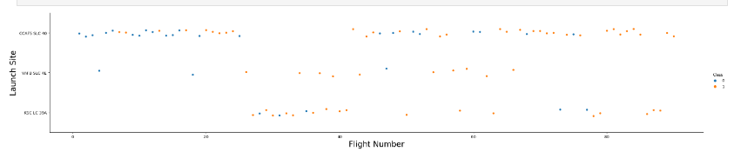
Flight Number vs. Launch Site
Flights at the beginning failed however, with time the number of successful flights increased
CCAFS SLC 40 has highest number of successful flights

Slide 19
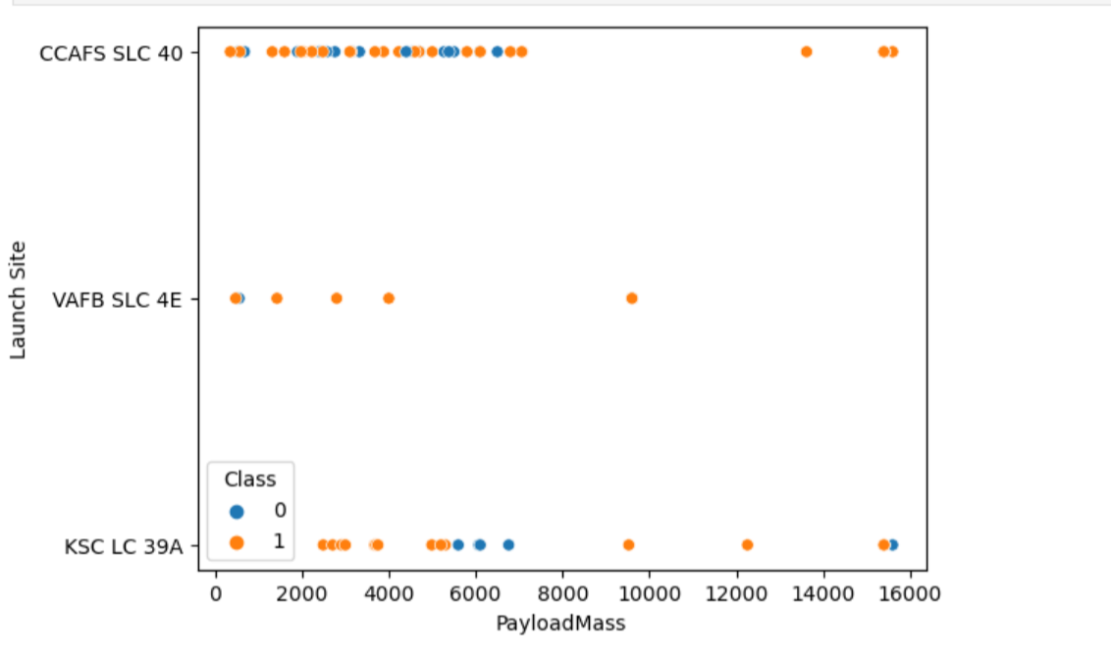
Payload vs. Launch Site
The class is labelled as 0 which means failure; and 1 means Success
For payload mass between 2000 to 6000, CCAFS SLC 40 has highest success
KSC –LC-39 A has higehst success rate overall

Slide 20
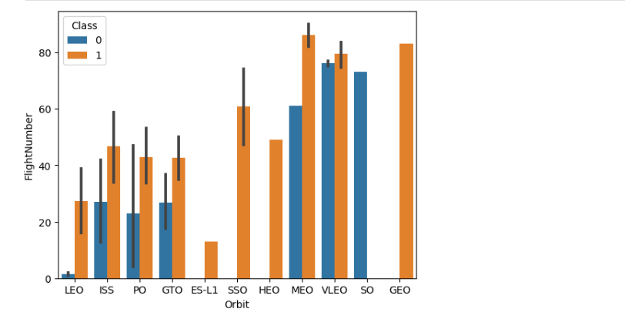
Success Rate vs. Orbit Type
Geo, SSO, ES-L1 has 100% success rate
SO has 0% success rate

Slide 21
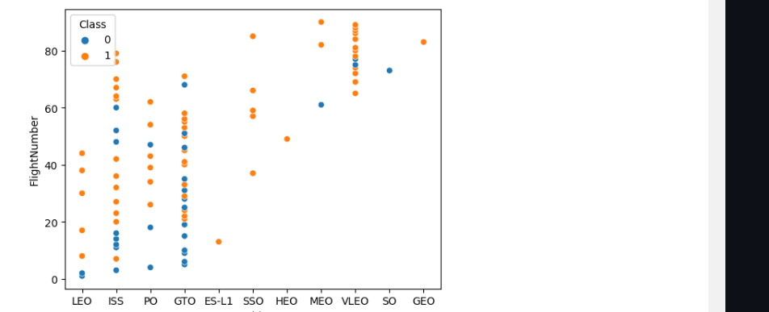
Flight Number vs. Orbit Type
Geo, SSO, ES-L1 has 100% success rate​
SO has 0% success rate

Slide 22
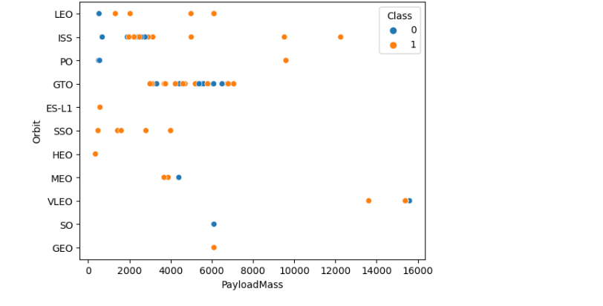
Payload vs. Orbit Type
With heavy payloads the successful landing or positive landing rate are more for Polar,LEO and ISS.
However for GTO we cannot distinguish this well as both positive landing rate and negative landing(unsuccessful mission) are both there here

Slide 23
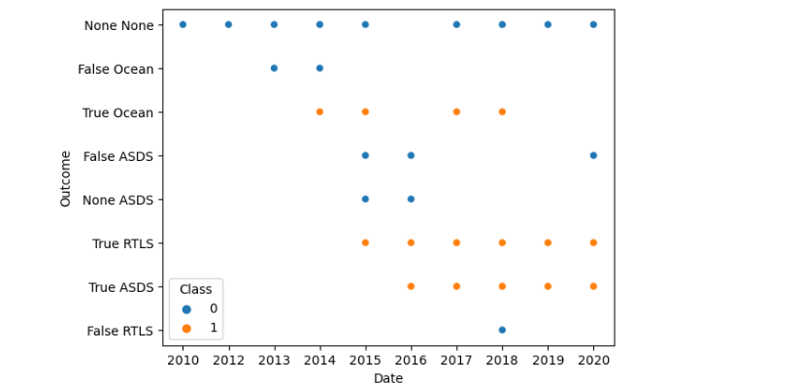
Launch Success Yearly Trend
Year 2017 and 2018 has more successful outcomes
From year 2010 to 2013 there were no successful outcomes

Slide 24
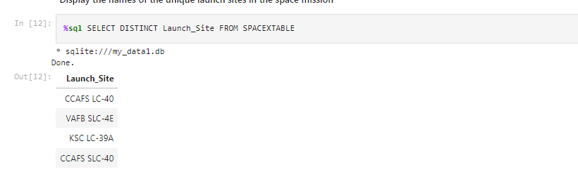
All Launch Site Names
The names of the unique launch sites

Slide 25
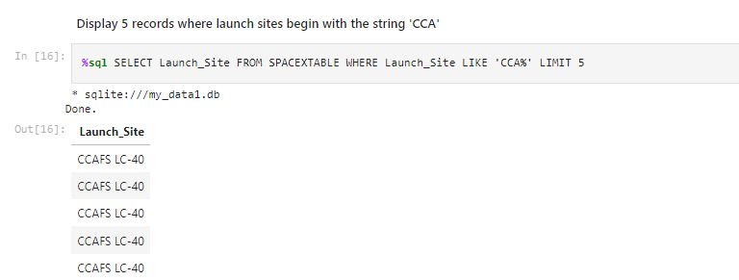
Launch Site Names Begin with 'CCA'
Names of Launch Site begin with 'CCA'

Slide 26
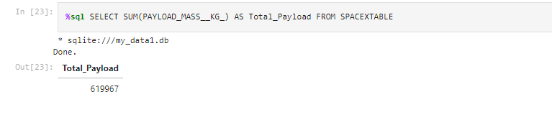
Total Payload Mass
Total Payload Mass

Slide 27
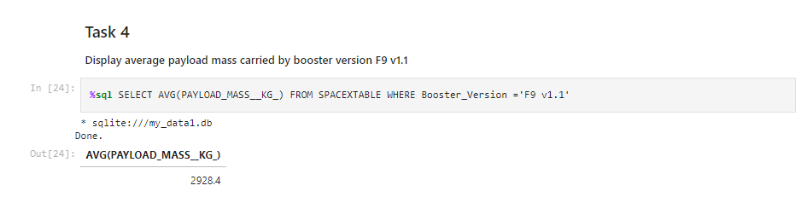
Average Payload Mass by F9 v1.1
Average Payload Mass of F9 v1.1

Slide 28
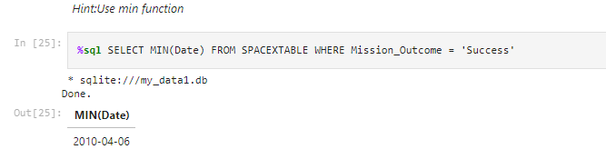
First Successful Ground Landing Date
First date of successful ground landing

Slide 29
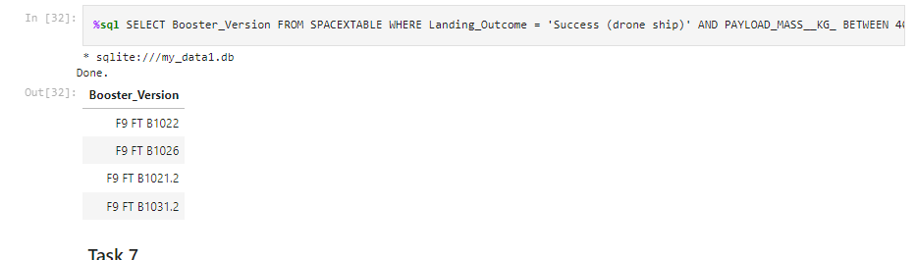
Successful Drone Ship Landing with Payload between 4000 and 6000
The names of boosters which have successfully landed on drone ship and had payload mass greater than 4000 but less than 6000

Slide 30
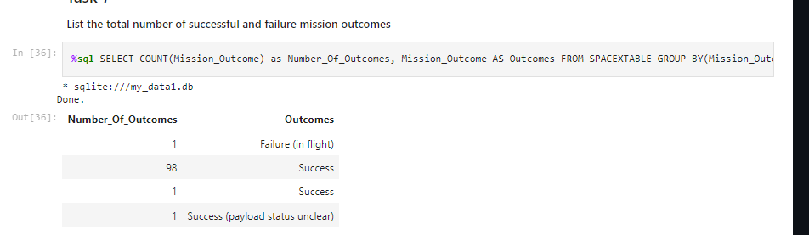
Total Number of Successful and Failure Mission Outcomes
The total number of successful and failure mission outcomes

Slide 31
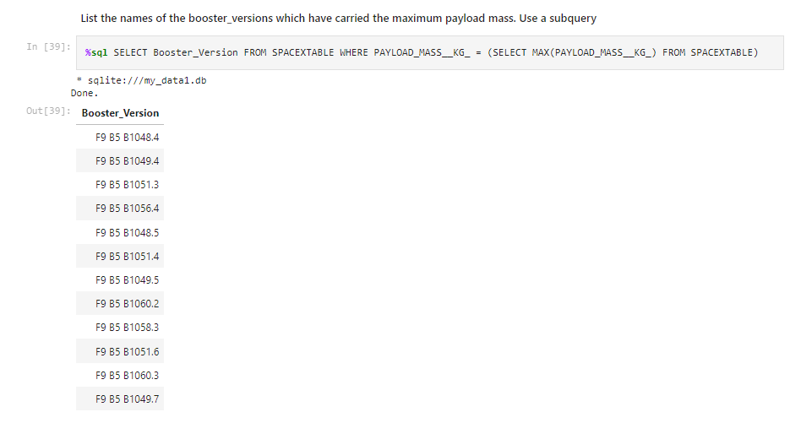
Boosters Carried Maximum Payload
The names of the booster which have carried the maximum payload mass

Slide 32
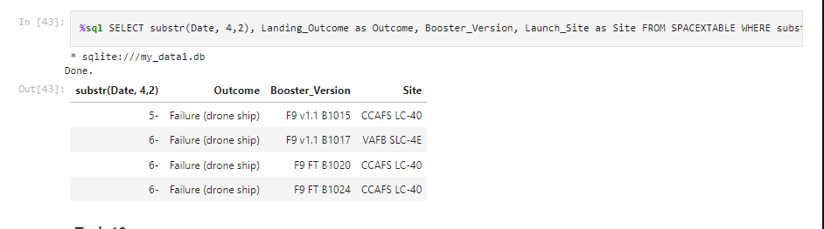
2015 Launch Records
The failed landing_outcomes in drone ship, their booster versions, and launch site names for in year 2015

Slide 33
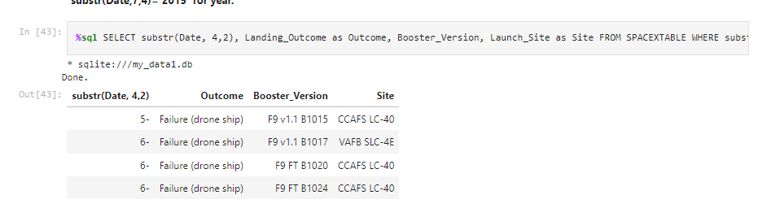
Rank Landing Outcomes Between 2010-06-04 and 2017-03-20
The count of landing outcomes (such as Failure (drone ship) or Success (ground pad)) between the date 2010-06-04 and 2017-03-20, in descending order

Slide 34

Section 3

Slide 35
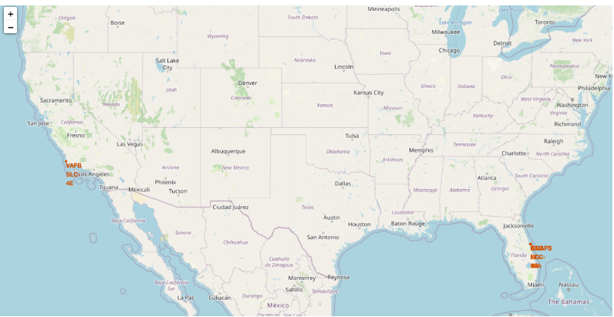
All launch sites
The launch sites are marked with red color. And we can decipher that all launch sites are closer to the coast.

Slide 36
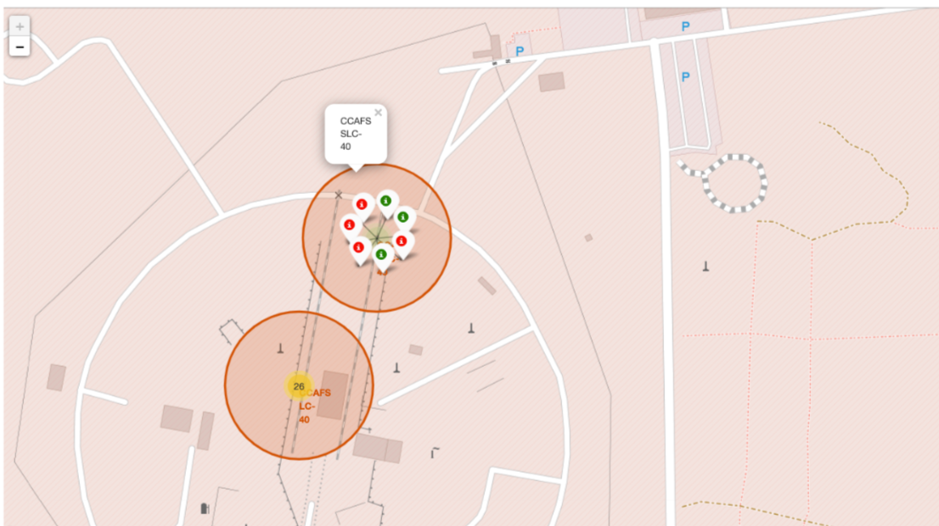
Labelled Launch Sites
Green Label = Successful Sites Launch
Red Label = Failure Site Launch

Slide 37
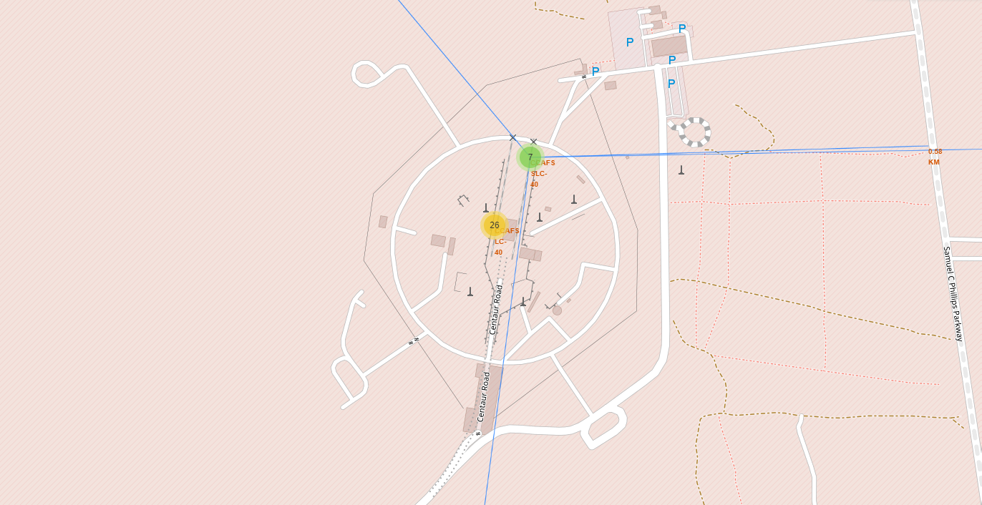
Distances of various points from launch sites

Slide 38

Section 4

Slide 39
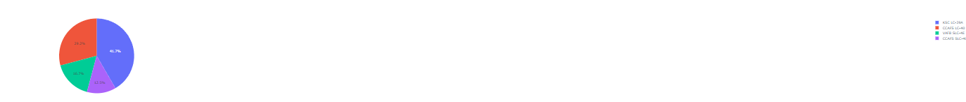
Pie Chart showing the Success Count of each site
KSC-LC-39A has highest success rate
CCAFS-LC-40 has lowest success rate

Slide 40
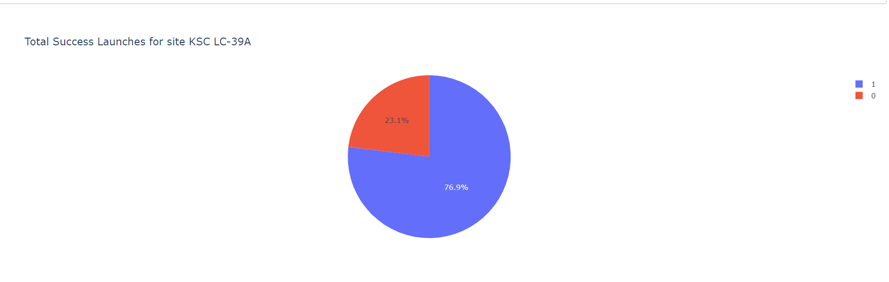
Pie chart of the launch site with highest successful rate
Success rate is 76.9% and Failure is 23.1%

Slide 41
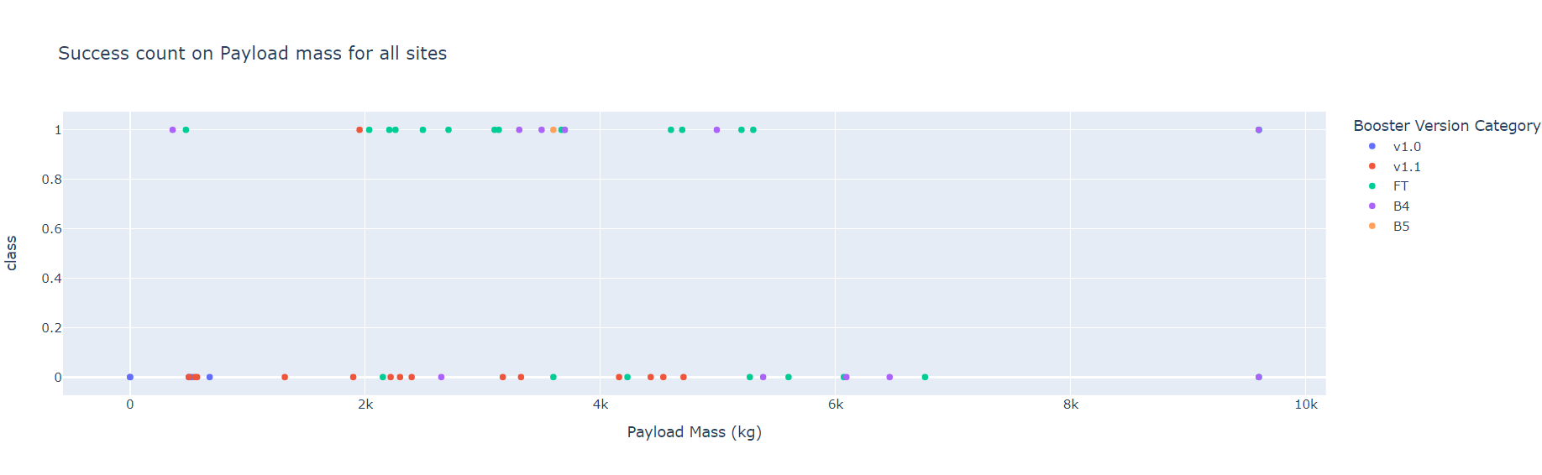
Payload Vs Launch Outcome Scatter Plot for all sites
Payload Mass between 2000 to 5000 has highest successful rate

Slide 42

Section 5

Slide 43
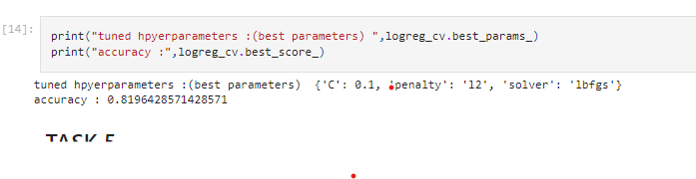
Classification Accuracy
Accuracy of Logistic regression

Slide 44
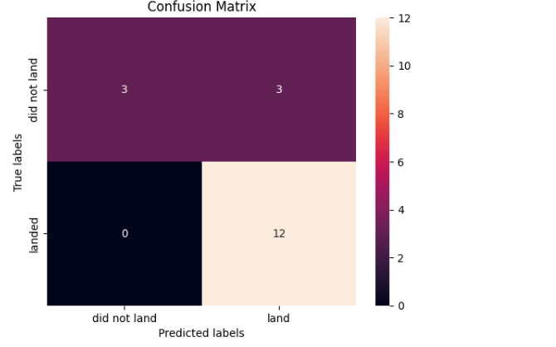
Confusion Matrix
False positive is the major issue.

Slide 45
Conclusions
Launches with a low payload mass show better results than launches with a larger payload mass.
KSC LC-39A has the highest success rate of the launches from all the sites.
Orbits ES-L1, GEO, HEO and SSO have 100% success rate.

Slide 46
Appendix
Special Thanks to IBM and Coursera

Slide 47


